Slide 1
Welcome to the Online Bookstore Analyst Project
Project by:- Chetan

Slide 2
Query to find insight from online bookstore dataset. Q1 Retrieve all books in the "Fiction" Genre Q2 find books published after the year 1950 Q3 List all customers from the Canada Q4 Show orders placed in November 2023 Q5 Retrieve the total stock of book available Q6 find the details of the most expensive book Q7 show all customers who ordered more then 1 quantity of a book Q8 Retrieve all orders where the total amount exceeds $20 Q9 list all genres available in the books table Q10 find the book with the lowest stock

Slide 3
Query to find insight from online bookstore dataset. Q11 calculate the total revenue generated form all order Q12 Retrieve the total number of books sold in each genre Q13 find the average price of books in the "Fantasy" genre Q14 list of customers who have placed at least 2 orders Q15 find the most frequent ordered book Q16 show that top 3 most expensive books of "Fantasy" Genre Q17 Retrieve the total quantity of book sold by each auther Q18 list the cities where customers who spend over $30 located Q19 find the customer who spend the most on order Q20 calculate the stock remaining after fulfilling all orders

Slide 4

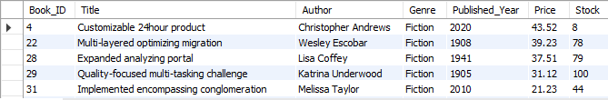
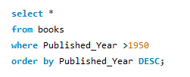
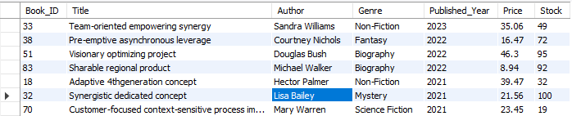
Q1 Retrieve all books in the "Fiction" Genre
Query:-
Output:-
Q2 find books published after the year 1950
Query:-
Output:-

Slide 5


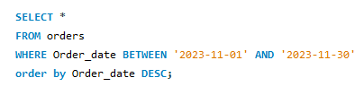
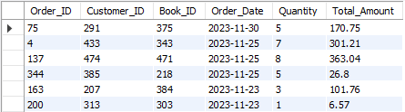
Q3 List all customers from the Canada
Query:-
Output:-
Q4 Show orders placed in November 2023
Query:-
Output:-

Slide 6


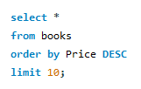
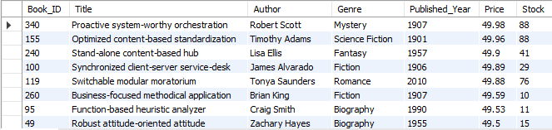
Q5 Retrieve the total stock of book available
Query:-
Output:-
Q6 find the details of the most expensive book
Query:-
Output:-

Slide 7
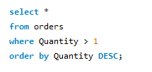
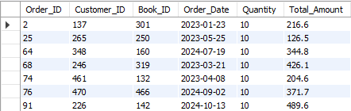
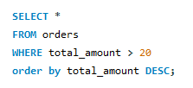
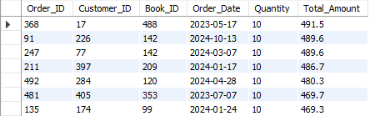
Q7 show all customers who ordered more then 1 quantity of a book
Query:-
Output:-
Q8 Retrieve all orders where the total amount exceeds $20
Query:-
Output:-

Slide 8

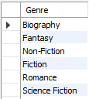

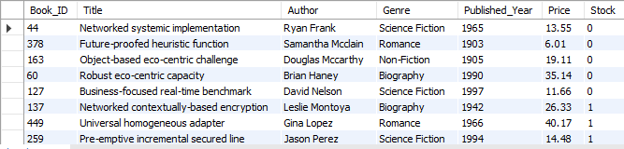
Q9 list all genres available in the books table
Query:-
Output:-
Q10 find the book with the lowest stock
Query:-
Output:-

Slide 9


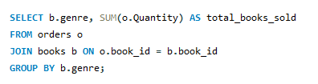
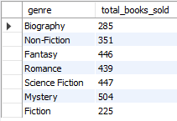
Q11 calculate the total revenue generated form all order
Query:-
Output:-
Q12 Retrieve the total number of books sold in each genre
Query:-
Output:-

Slide 10


Q13 find the average price of books in the "Fantasy" genre
Query:-
Output:-
conclusion
This query will return a single row containing the genre "Fantasy" and the corresponding average price of all books in this category. If no books belong to the "Fantasy" genre, the result will be NULL.

Slide 11
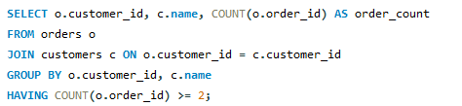
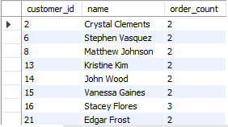
Conclusion The given SQL query retrieves customers who have placed at least two orders. It does this by: 1. Joining: the orders table (o) with the customers table (c) on customer_id. 2.Grouping: the results by customer_id and customer name. 3.Counting: the number of orders (order_id) for each customer. 4.Filtering: customers who have at least 2 orders using the HAVING clause. The output will contain customer IDs, customer names, and their total number of orders, but only for customers who have placed two or more orders.
Q14 list of customers who have placed at least 2 orders
Query:-
Output:-

Slide 12
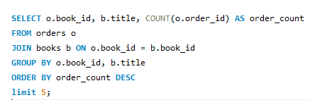
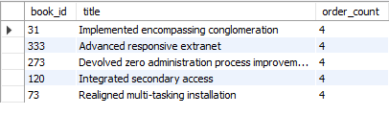
Conclusion The query identifies the top 5 most popular books based on the number of times they have been ordered. The output will include: 1. book_id: The unique identifier for each book. 2. title: The title of the book. 3. order_count: The total number of orders for that book. This information can be useful for: 1. Identifying best-selling books. 2. Inventory management and restocking decisions. 3. Marketing strategies to promote popular books further.
Q15 find the most frequent ordered book
Query:-
Output:-

Slide 13
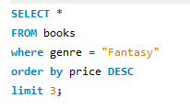

Q16 show that top 3 most expensive books of "Fantasy" Genre
Query:-
Output:-
Conclusion
The query identifies the top 3 most expensive Fantasy books in the database. The output will include all columns from the books table
(e.g., book_id, title, author, price, etc.) for these books.
This information can be useful for:
Identifying high-value Fantasy books for pricing analysis.
Targeting premium customers interested in expensive Fantasy books.
Understanding the price range of books within the Fantasy genre.
If the price column represents the cost of the book, this query helps highlight the most premium offerings in the Fantasy category.

Slide 14
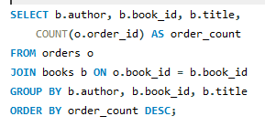
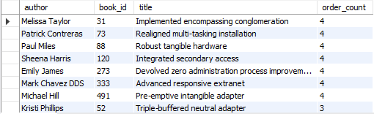
Q17 Retrieve the total quantity of book sold by each auther
Query:-
Output:-
Conclusion
The query identifies the popularity of books based on the number of orders, along with their authors and titles. The output will include:
author: The author of the book.
book_id: The unique identifier for the book.
title: The title of the book.
order_count: The total number of orders for that book.
This information can be useful for:
Identifying best-selling books and authors.
Understanding which books and authors are most in demand.
Making data-driven decisions for inventory management, marketing campaigns, and promotions.
By ordering the results in descending order of order_count, the query highlights the most popular books at the top, providing valuable insights into customer preferences.

Slide 15
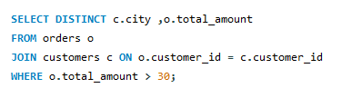
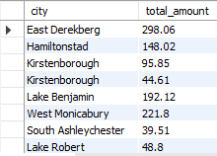
Q18 list the cities where customers who spend over $30 located
Query:-
Output:-
Conclusion
The query identifies cities where customers have placed orders with a total amount greater than 30.
This information can be useful for:
Analyzing geographic distribution of high-value orders (orders with a total_amount greater than 30).
Identifying cities with customers who spend more, which can help in targeted marketing or business expansion strategies.
Understanding spending patterns across different regions.
By using DISTINCT, the query ensures that duplicate rows (e.g., the same city and order amount) are eliminated, providing a clean and concise result. This data can help businesses focus on high-value customer segments and tailor strategies to maximize revenue.

Slide 16
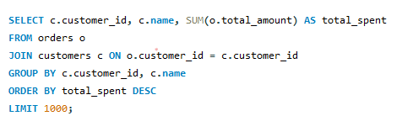
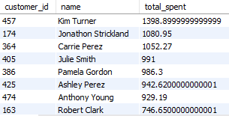
Q19 find the customer who spend the most on order
Query:-
Output:-
Conclusion
The query identifies the top 1,000 highest-spending customers and their total expenditure across all orders.
This information can be useful for:
Identifying high-value customers who contribute the most to revenue.
Tailoring loyalty programs, discounts, or special offers to retain these customers.
Analyzing customer spending patterns to improve marketing strategies and customer engagement.
Focusing business efforts on the most profitable customer segments.
By limiting the results to the top 1,000 customers, the query provides actionable insights into the most valuable customers, helping businesses prioritize their resources and strategies effectively.

Slide 17
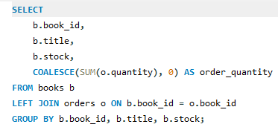
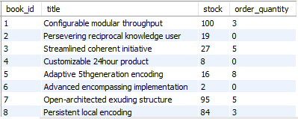
Q20 calculate the stock remaining after fulfilling all orders
Query:-
Output:-
Conclusion
The query provides a comprehensive overview of books, their current stock levels, and the total quantity ordered for each book.
This information can be useful for:
Inventory management: Identifying books with low stock levels or high demand.
Demand analysis: Understanding which books are popular based on the quantity ordered.
Restocking decisions: Prioritizing books that are frequently ordered but have low stock.
Identifying slow-moving items: Books with no orders or low order quantities may need promotional efforts.
By using a LEFT JOIN and COALESCE, the query ensures that all books are included in the result, even if they have never been ordered, providing a complete picture of the inventory and sales performance.

Slide 18
Thank You

